Slide 1
Week 3

Slide 2
Week 3
Dataset: BCI Competition 2008 – Graz data set A
9 subjects, 22 Channels, 1001 samples (250 Hz, 4 seconds of data)
576 trials (12 trials per class, 4 classes per run, 6 runs, 2 sessions)
Files separated into data, labels, and metadata for each subject
Data saved per subject (trials x channels x samples)
Preprocessing:
Used MOABB to load the data
Subject data for training/validation/testing merged together
6 subjects used for training
2 subjects used for validation
1 subject used for validation
Ideally will rerun but using K-fold, to avoid bias

Slide 3
Week 3
Simple NN model:
Created using Pytorch
3 Blocks of 2D convolutions and MaxPooling
Worst performing accuracy, only slightly higher than chance (25%)
Imported EEGNet Model:
Imported from GitHub
Written in Keras
Training took the longest

Slide 4
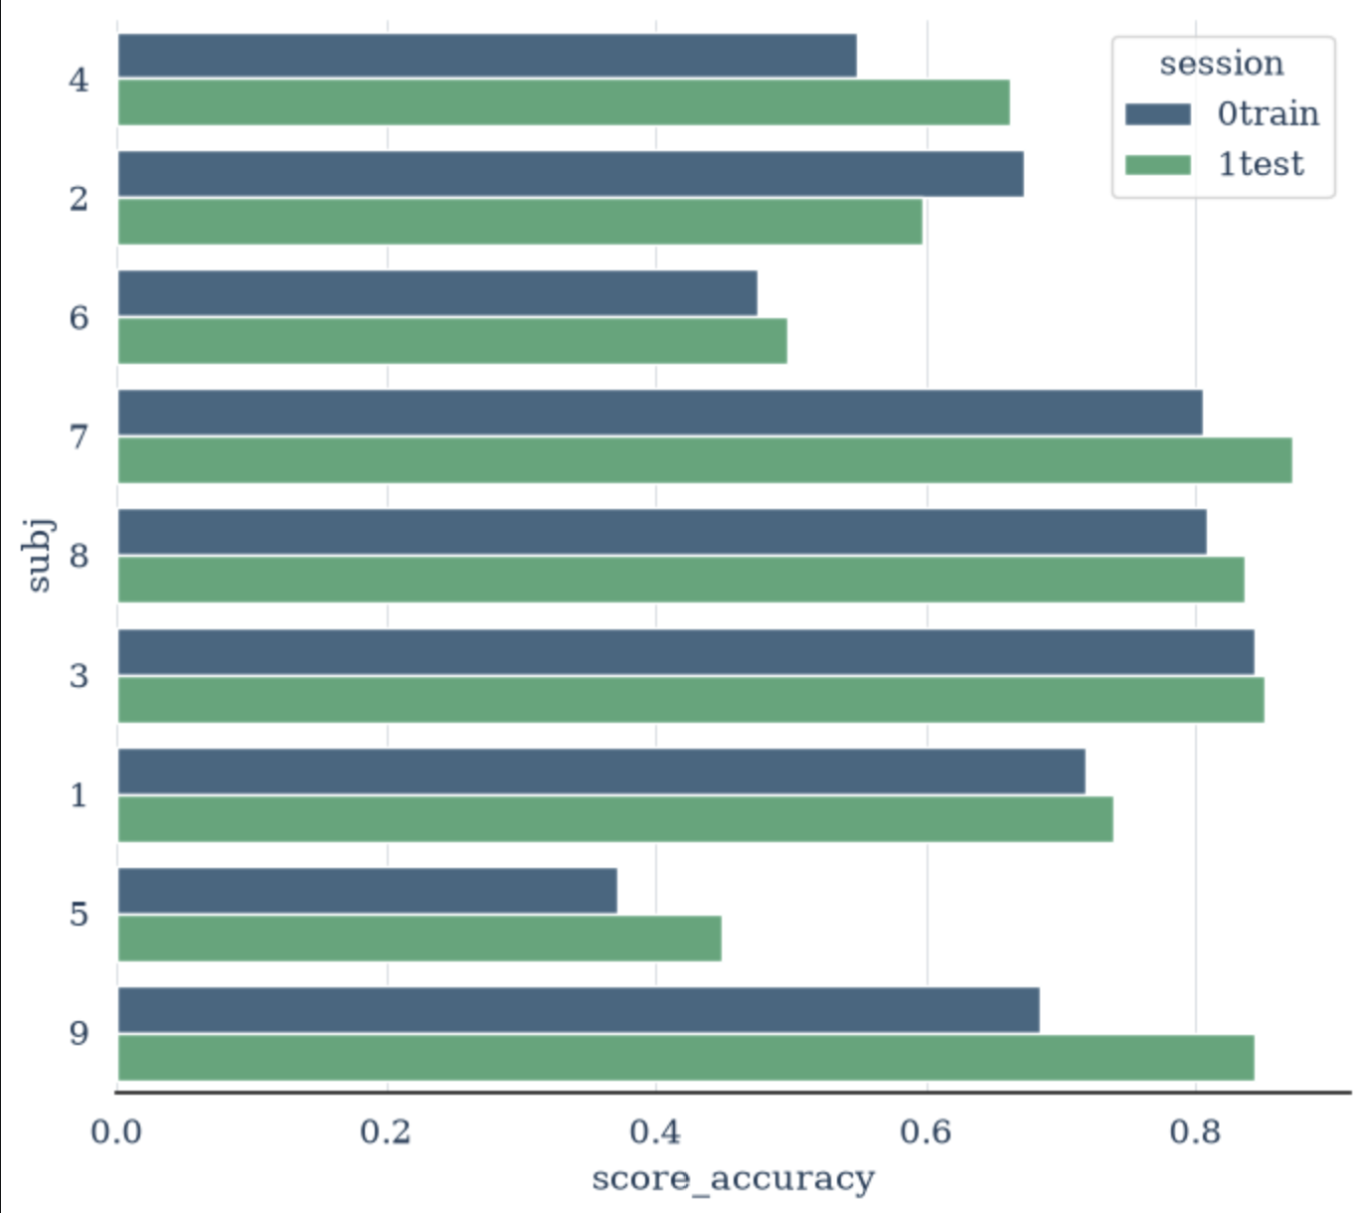
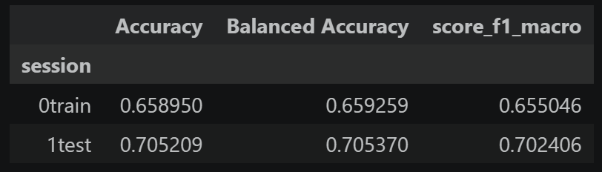
Week 3
Simple CSP + LDA model:
Mostly used for data exploration
Created using the MOABB library
“Best performance and fastest training”
NOTE: only model that used K-fold

Slide 5
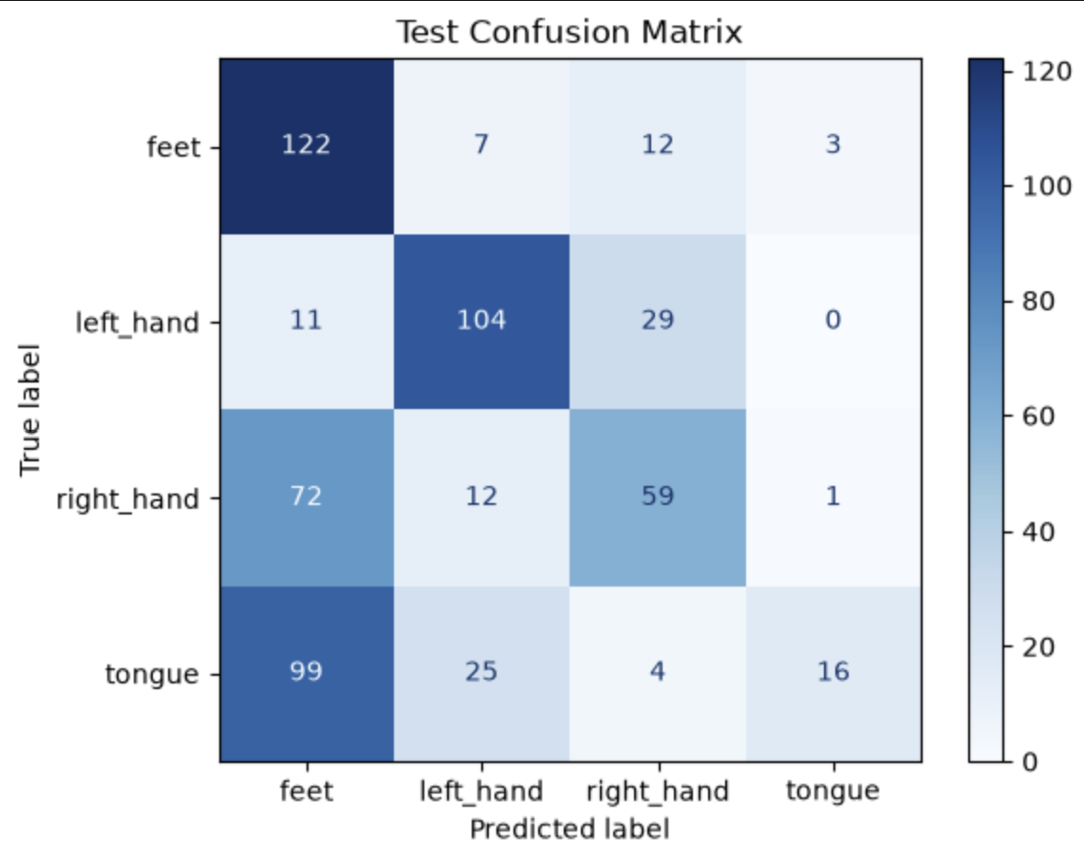
Week 3
EEGNet converted to Pytorch
Similar accuracy to the Keras model
However, significantly faster

Slide 6
Week 3
Challenges:
Understanding and manipulating the data
Used the MOABB website, guides, and tutorials
Significant difference in accuracy when converting Keras to Pytorch:
Comparing the default values showed difference in multiple functions
Difference in layer order requirements caused multiple issues
Running the original EEGNet model needed a new environment and managing the requirements

Slide 7
Week 4

Slide 8
Week 4
Baseline: CSP + LDA model
70.5% accuracy
Experiments:
Preprocessing on both train and test:
Multiple values tested, tests averaged

Slide 9
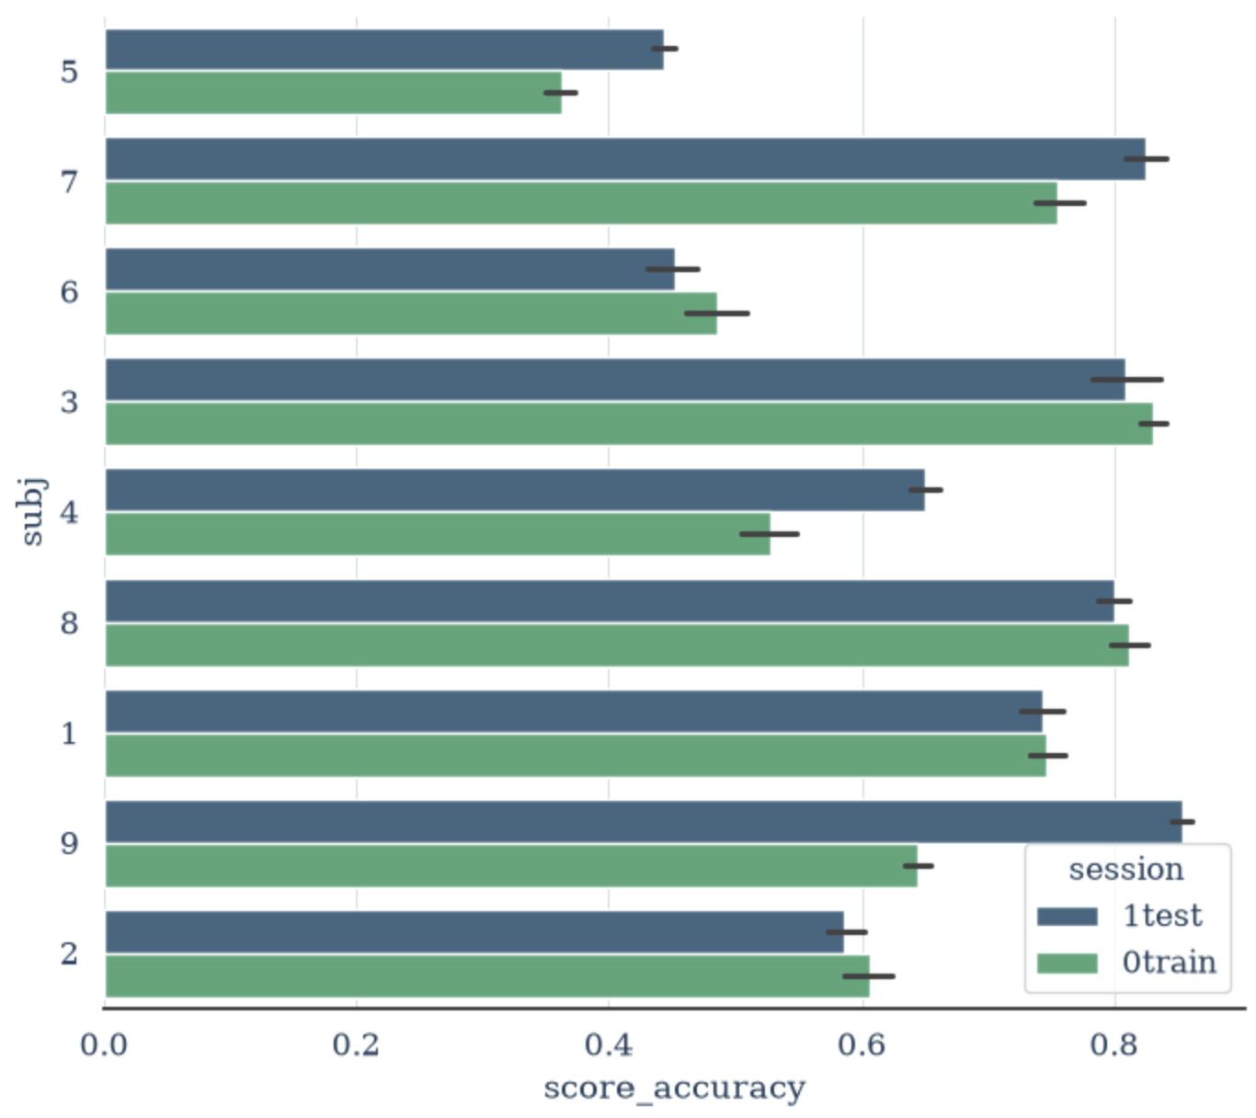
Week 4
Robustness to missing data:
4 missing channels selected at random, repeated 10 times and averaged
Test accuracy: 68.5%

Slide 10
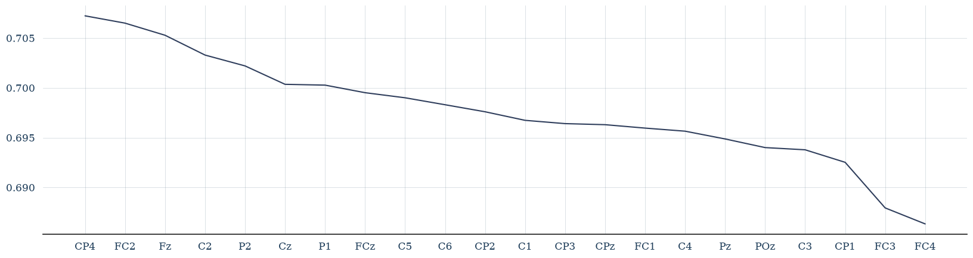





Fronto-Central: Motor planning , cognitive control, and executive function
Notes:
https://neuroanalyzer.org/tutorials/locs.html#d-preview

Slide 11
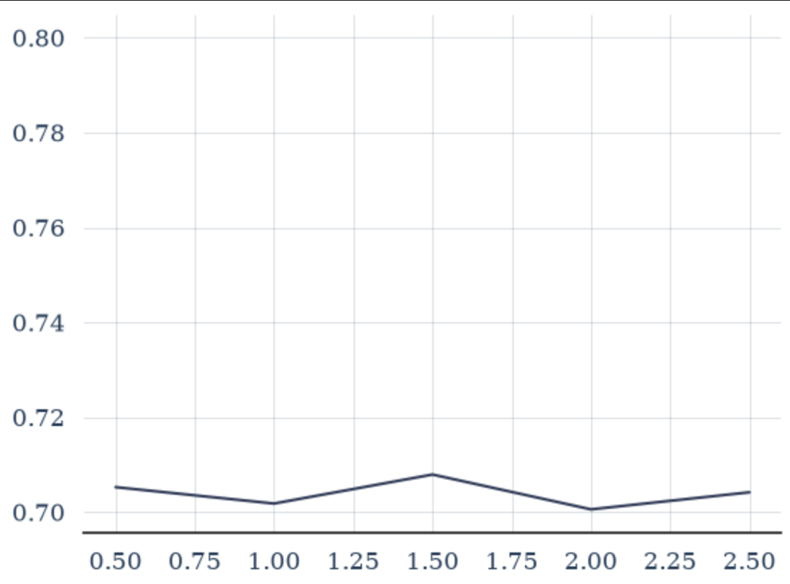
Week 4
Robustness to scaling:
Scaled on 4 Random channels, twice. Results were averaged
Scaled on 5 factors = [0.5, 1, 1.5, 2, 2.5, 3, 4, 5]
70.5% accuracy

Slide 12
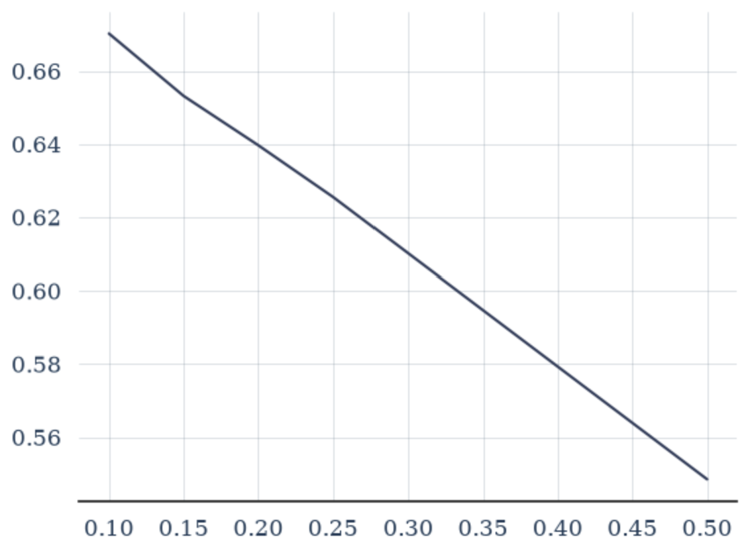
Week 4
Robustness to noise:
Added noise to all channels, 5 times. Results were averaged
Levels= 0.02-0.5
62.7% accuracy

Slide 13
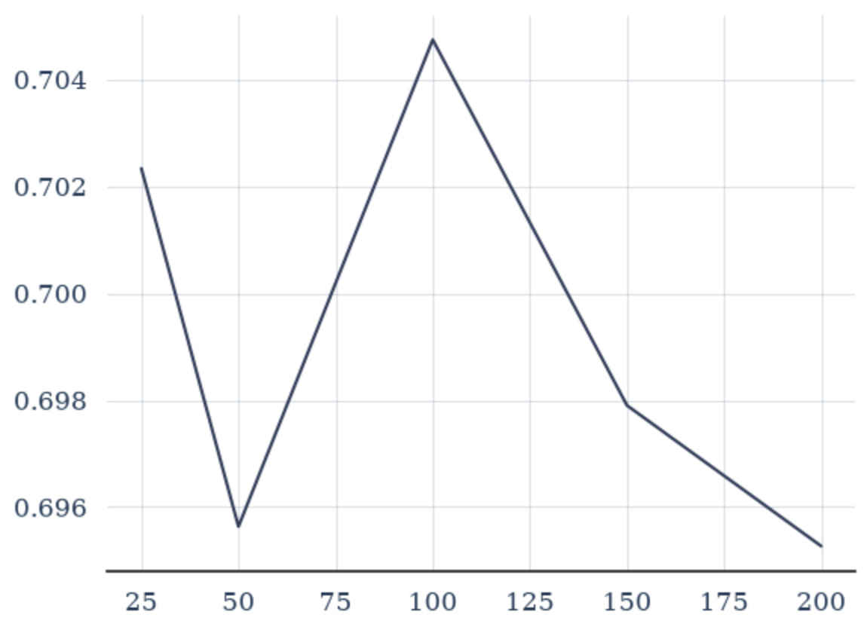
Week 4
Robustness to missing durations:
Removed durations from a random channel, repeated twice. Results averaged
durations=[25, 50, 100, 150, 200]
69.9% accuracy

Slide 14
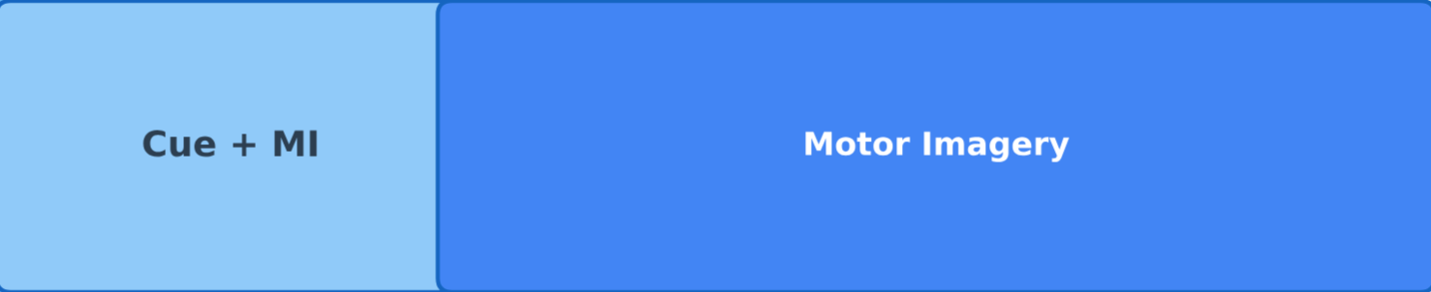
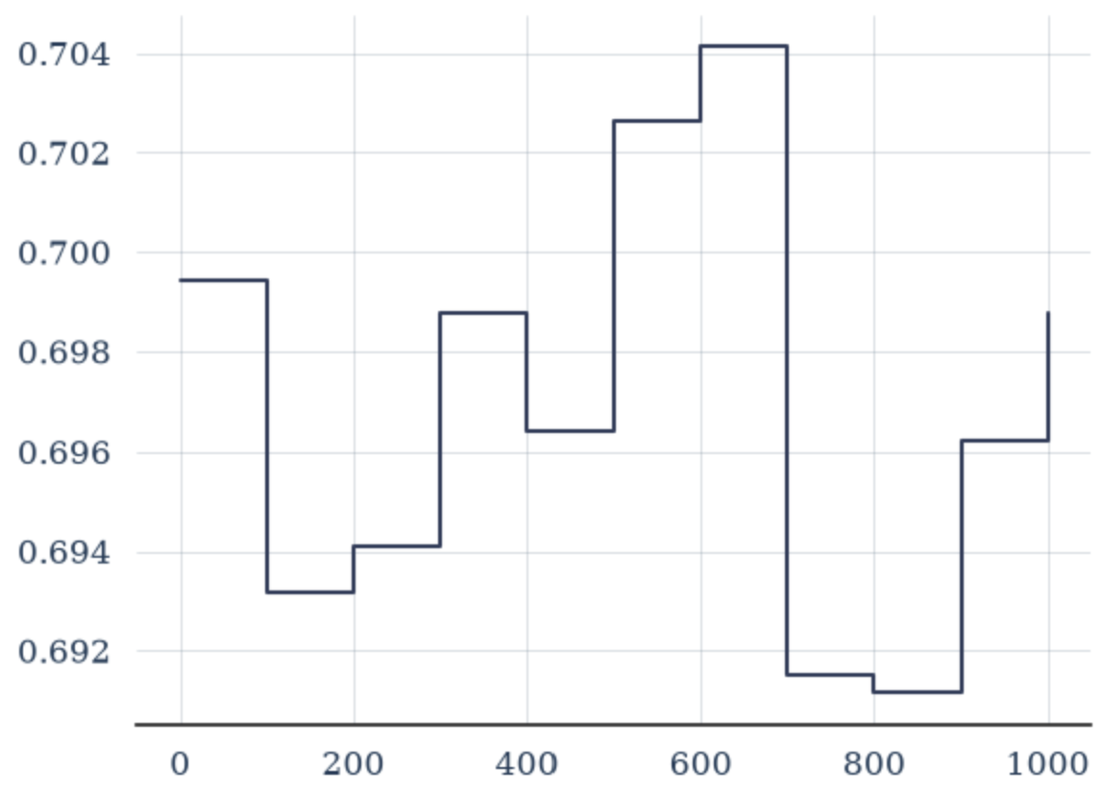
Week 4
Robustness to missing durations:
Removed 200 durations from FC3 and FC4

Slide 15
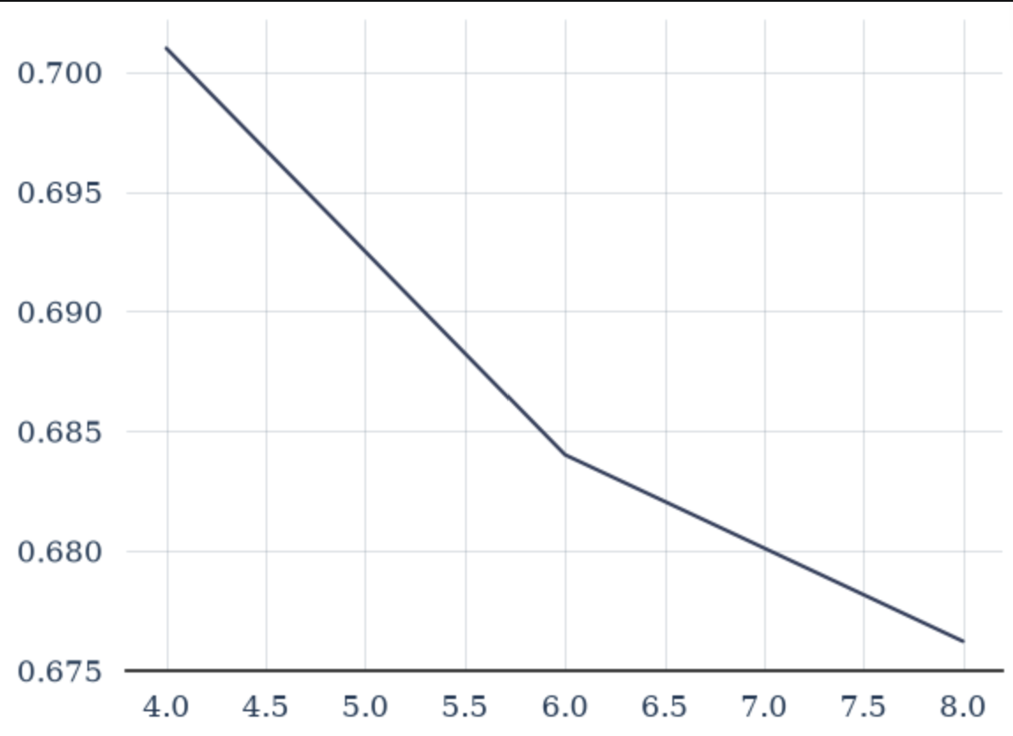
Week 4
Robustness to missing frequencies:
Removed different frequencies from bandwidths 4-8, repeated thrice. Results averaged
Bandwidths=[4,6,8]
68.7% accuracy

Slide 16
Week 4
Summary
 | Baseline | Scaling | Missing durations | Missing frequencies | Missing data | Noise
Accuracy | 70.5% | 70.5% | 69.9% | 68.7% | 68.5% | 62.7%

Slide 17
Week 5

Slide 18
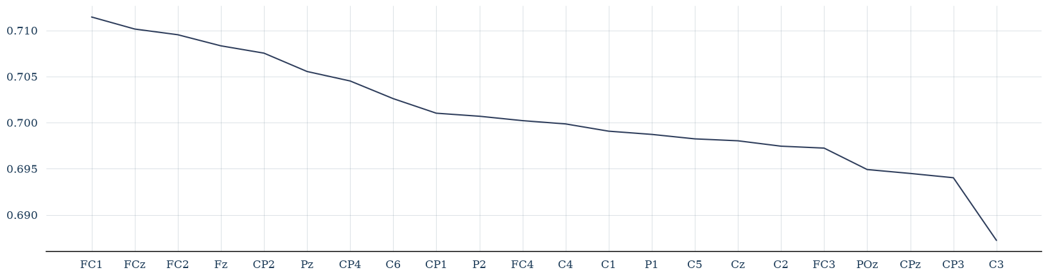
Week 5
Missing data:
Both preprocessed:
Train only preprocessed:

Slide 19
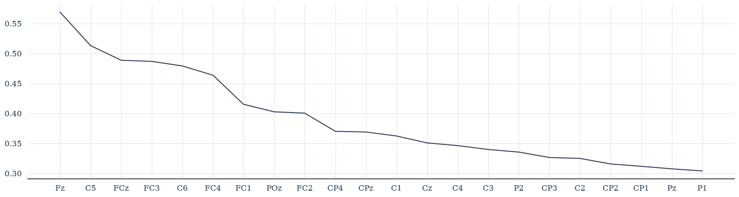
Week 5
Missing data:
Test only preprocessed:

Slide 20
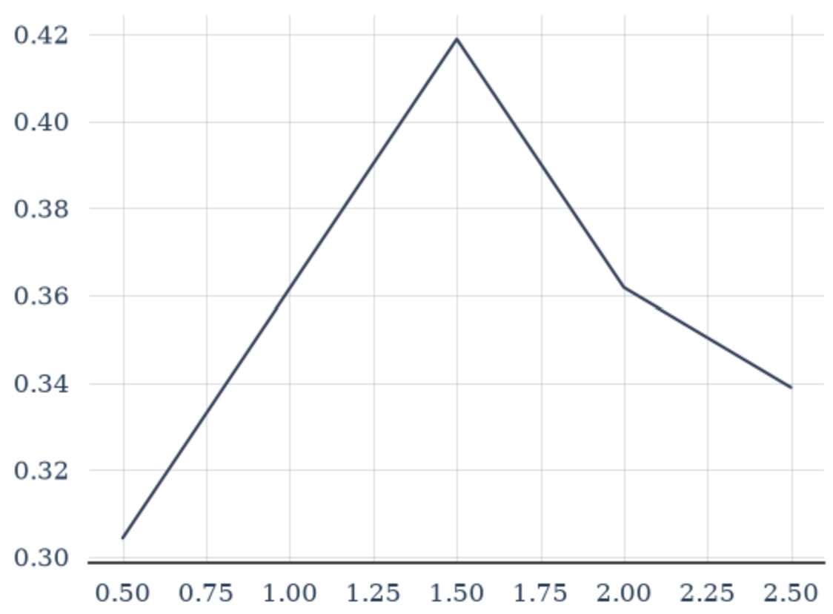
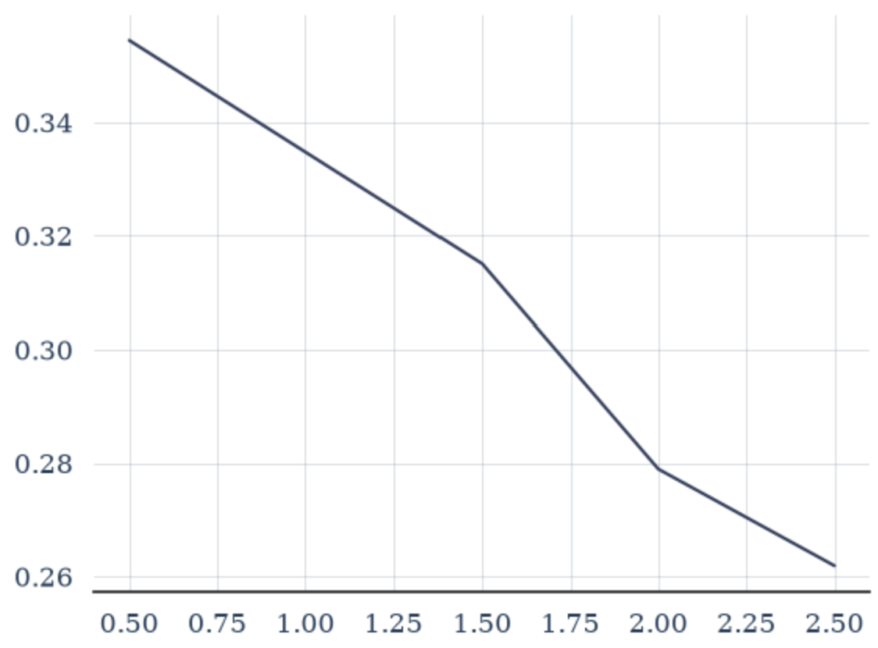
Week 5
Scaling:
Both preprocessed
Train preprocessed
Test preprocessed

Slide 21
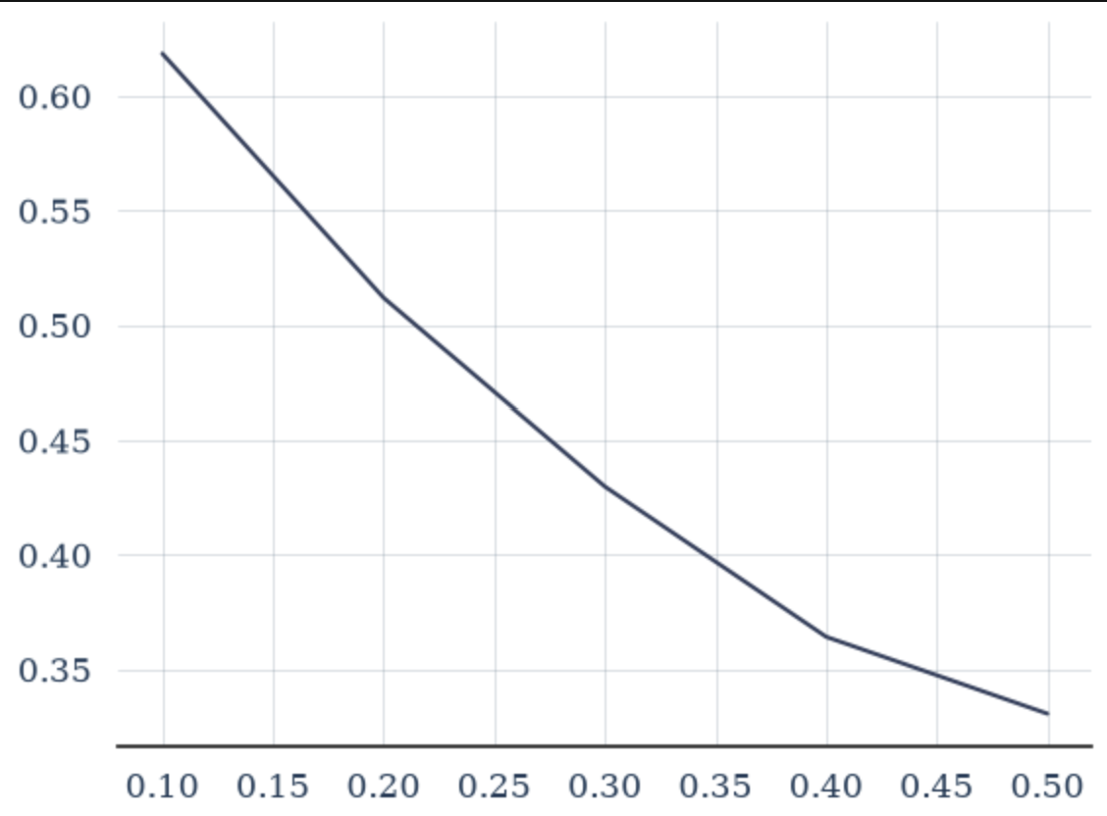
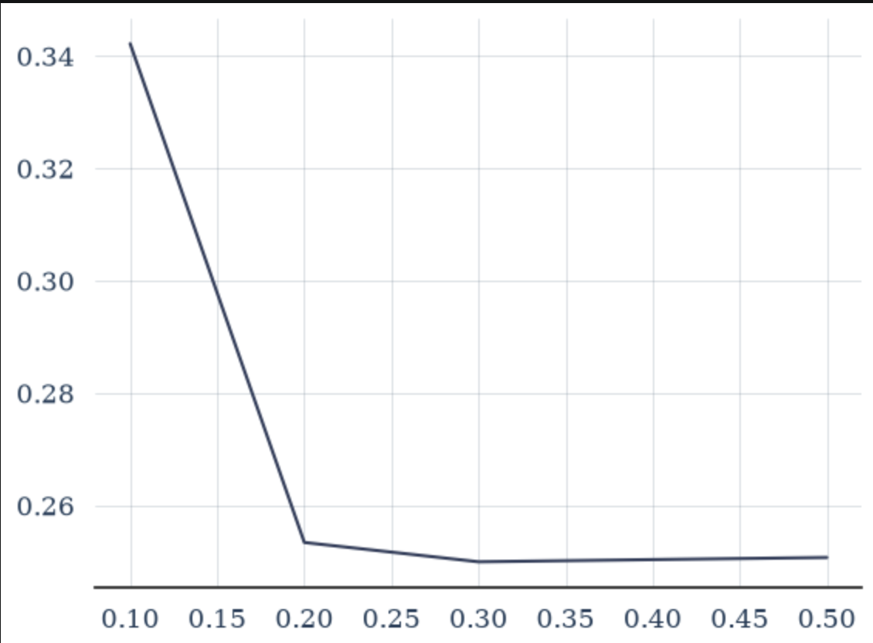
Week 5
Noise:
Both preprocessed
Train preprocessed
Test preprocessed

Slide 22
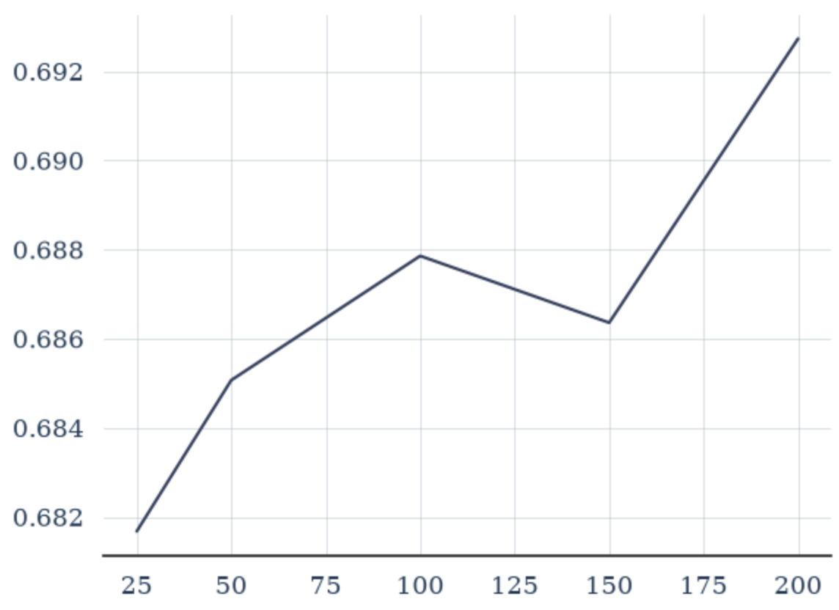
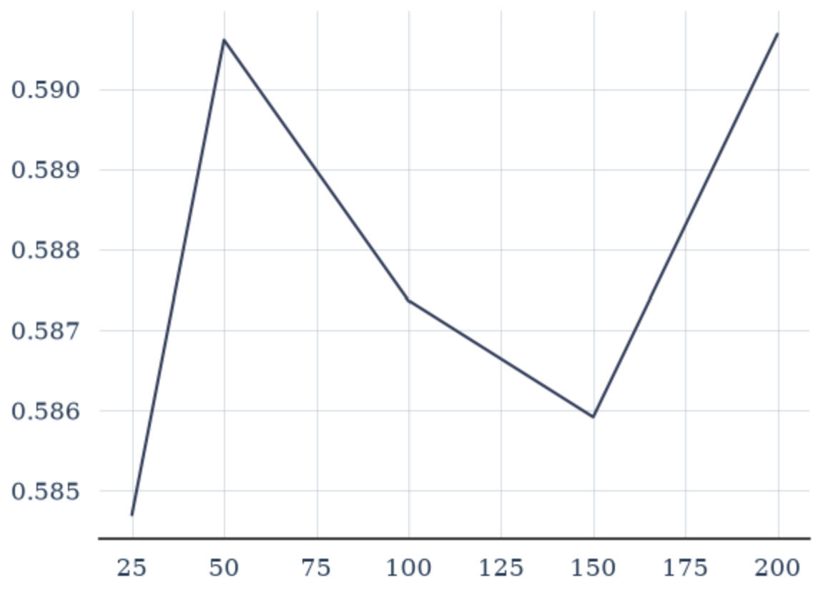
Week 5
Missing durations:
Both preprocessed
Train preprocessed
Test preprocessed

Slide 23
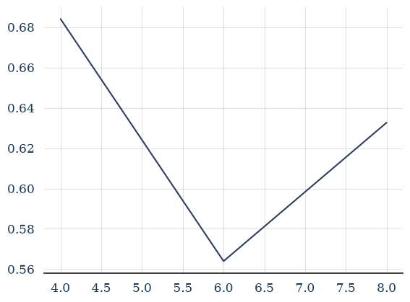
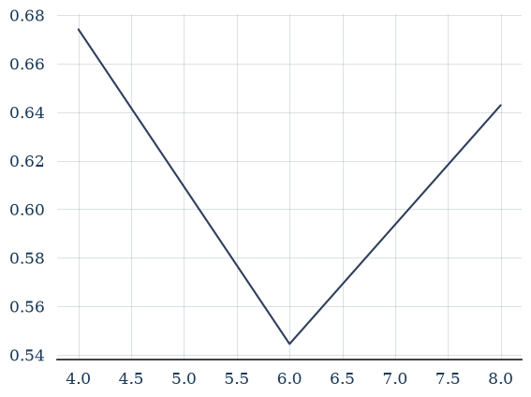
Week 5
Missing frequencies:
Both preprocessed
Train preprocessed
Test preprocessed

Slide 24
Week 5
Baseline 70.5%
 | Scaling | Missing durations | Missing frequencies | Missing data | Noise
Both prep. | 70.5% | 69.9% | 68.7% | 68.5% | 62.7%
Train only | 35.6% | 68.7% | 62.7% | 70.1% | 45.1%
Test only | 30.3% | 58.8% | 62.1% | 39.0% | 26.9%

Slide 25
Week 6

Slide 26
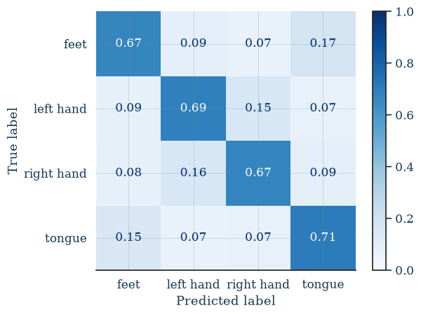
Csp lda
- Accuracy: 70.1
- Recall: 68.5

Slide 27
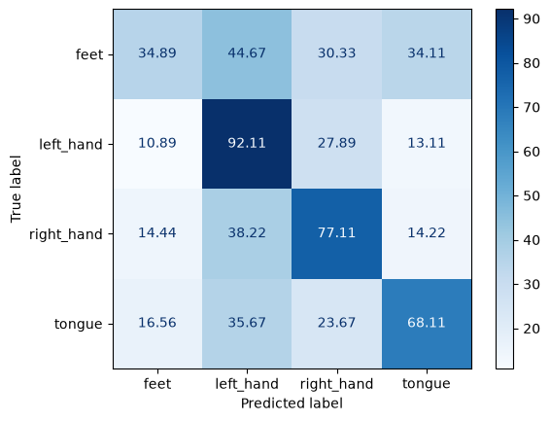
eegnet
Best accuracy: 63.1%
Recall: 63.7

Slide 28
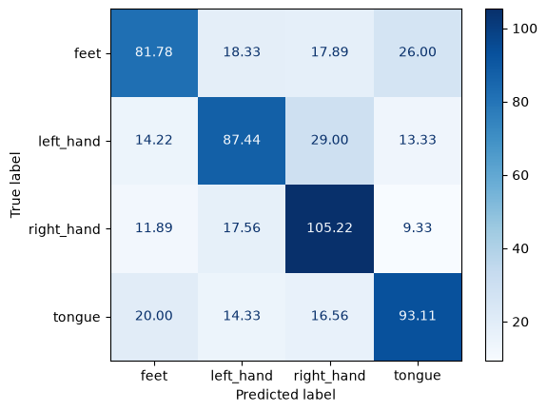
Eegnet – Scaling – both
 | 0.5 | 1.5 | 2 | 2.5
Acc | 63.4 | 63.5 | 63.5 | 63.8

Slide 29
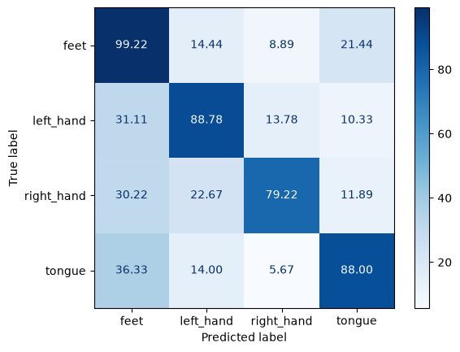
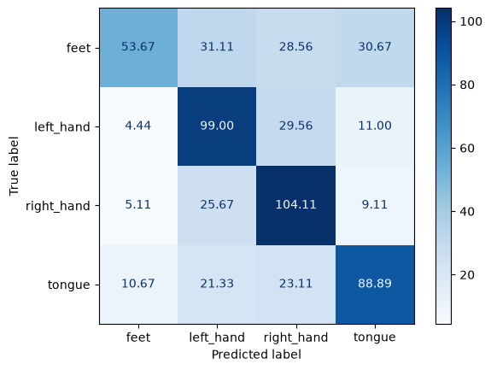
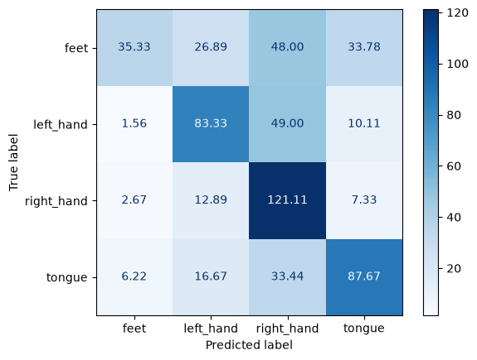
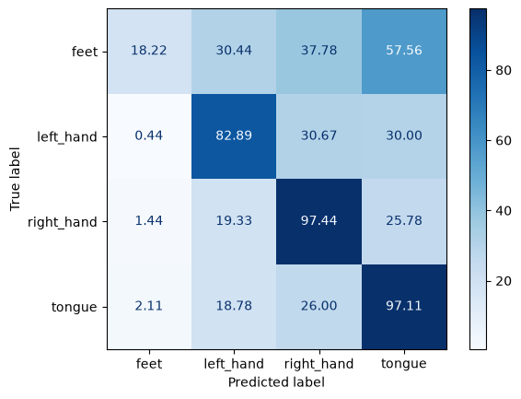
Eegnet – Scaling – Train
 | 0.5 | 1.5 | 2 | 2.5
Acc | 61.7 | 60.0 | 56.9 | 51.3

Slide 30
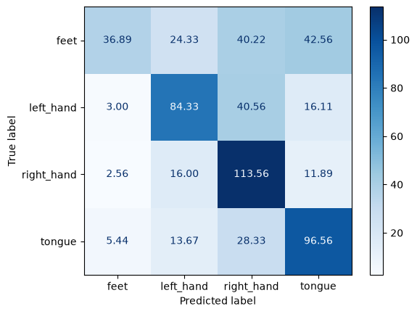

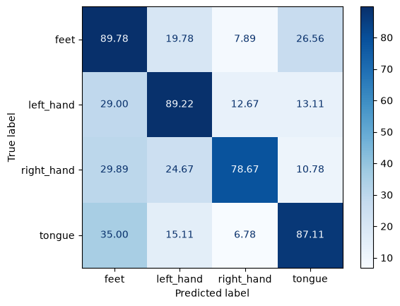
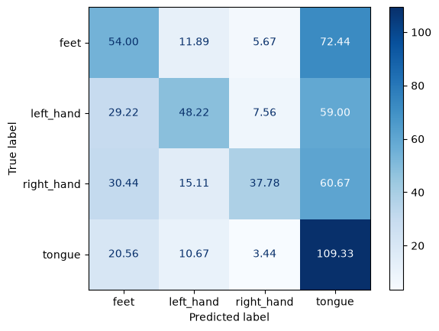
Eegnet – Scaling – test
 | 0.5 | 1.5 | 2 | 2.5
Acc | 57.5 | 62.5 | 59.9 | 43.3

Slide 31
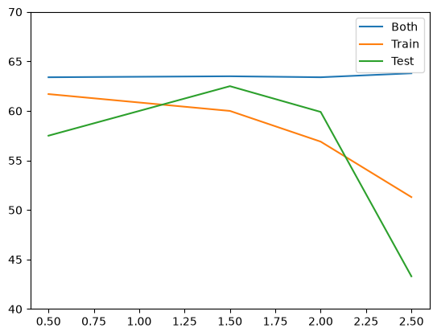
Eegnet – Scaling – summary
Feet degraded the most
Larger scales cause classes to be confused as tongue

Slide 32
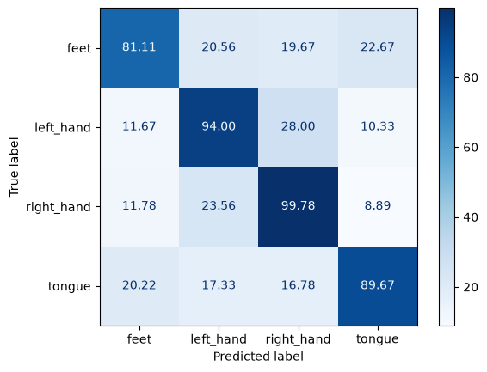


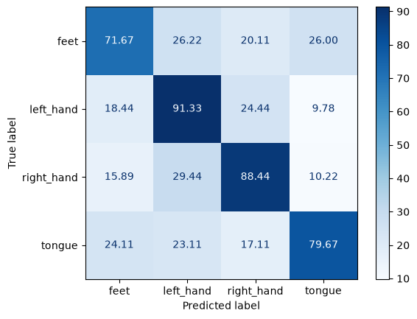
Eegnet – noise – both
 | 0.1 | 0.2 | 0.3 | 0.4
Acc | 63.3 | 60.6 | 58.9 | 57.5

Slide 33
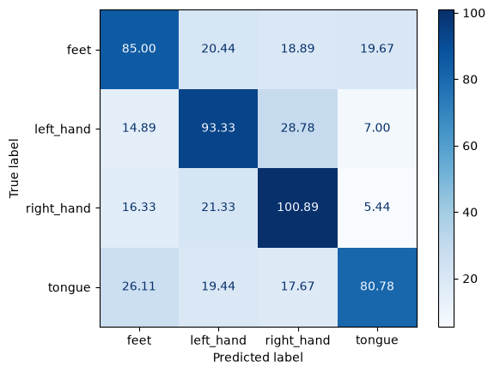



Eegnet – noise – train
 | 0.1 | 0.2 | 0.3 | 0.4
Acc | 62.5 | 62.3 | 60.6 | 58.9%

Slide 34


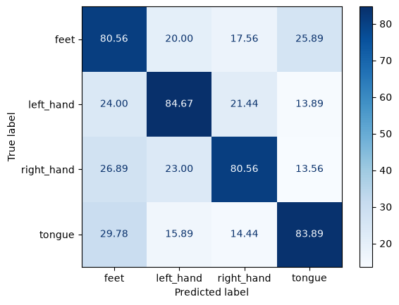
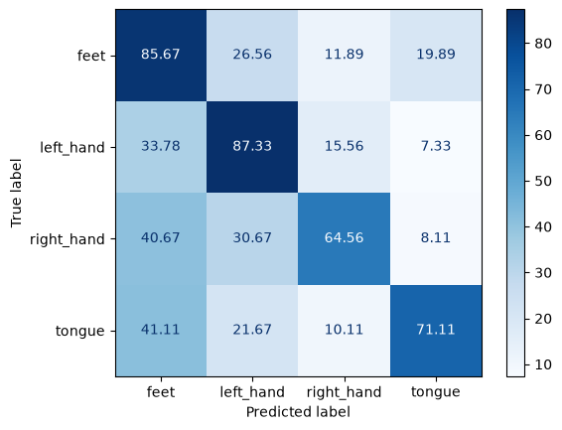
Eegnet – noise – test set only preprocessed
 | 0.1 | 0.2 | 0.3 | 0.4
Acc | 63.7 | 61.2 | 57.2 | 53.6

Slide 35
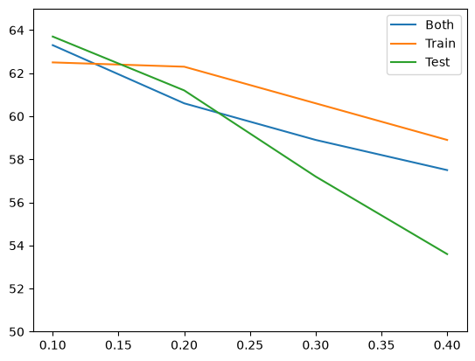
Eegnet – noise – summary
In Test, larger scales cause classes to be confused as feet

Slide 36




Eegnet – missing durations – both
 | 50 | 100 | 150 | 200
Acc | 62.3 | 62.5 | 62.7 | 63.2

Slide 37




Eegnet – missing durations – train
 | 50 | 100 | 150 | 200
Acc | 63.7 | 63.3 | 62.6 | 62.9

Slide 38


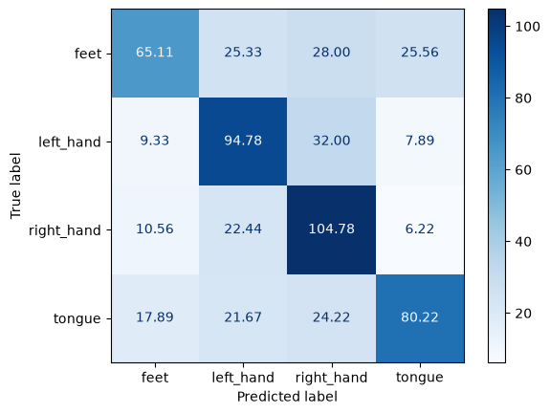
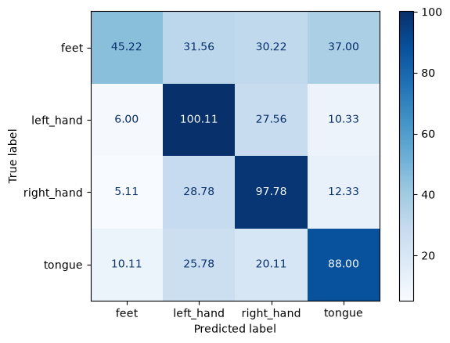
Eegnet – missing durations – Test
 | 50 | 100 | 150 | 200
Acc | 62.5 | 61.7 | 59.9 | 57.5

Slide 39
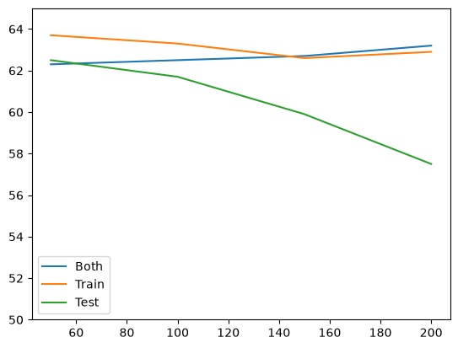
Eegnet – missing durations – summary
In test, duration increased, feet were classified as other classes

Slide 40
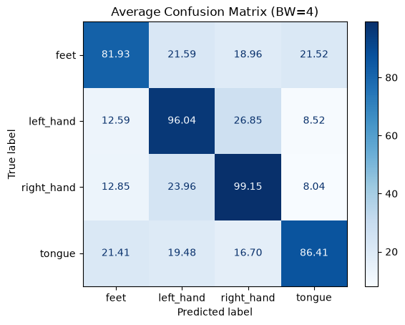
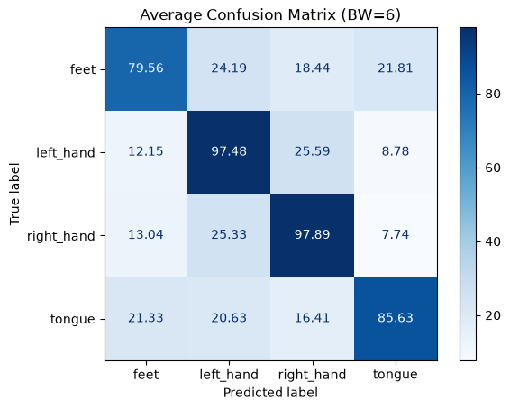
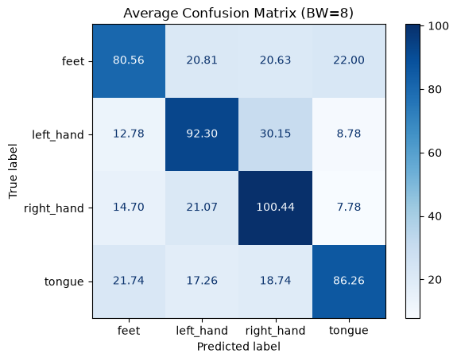
Eegnet – missing frequencies – both
 | 4 | 6 | 8
Acc | 63.1 | 62.6 | 62.4

Slide 41

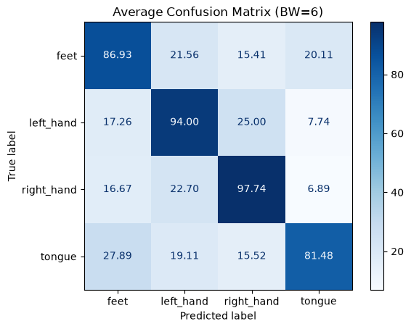
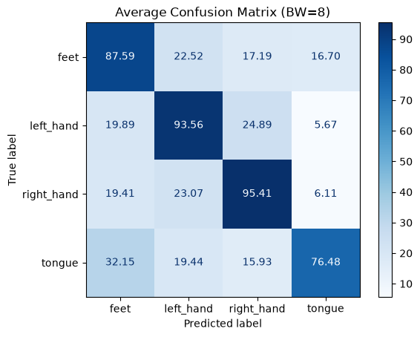
Eegnet – missing frequencies – train
 | 4 | 6 | 8
Acc | 62.9 | 62.5 | 62.3

Slide 42
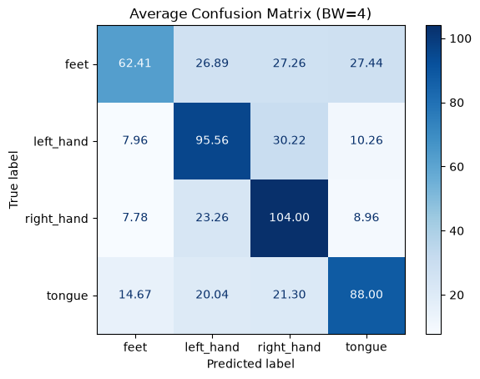
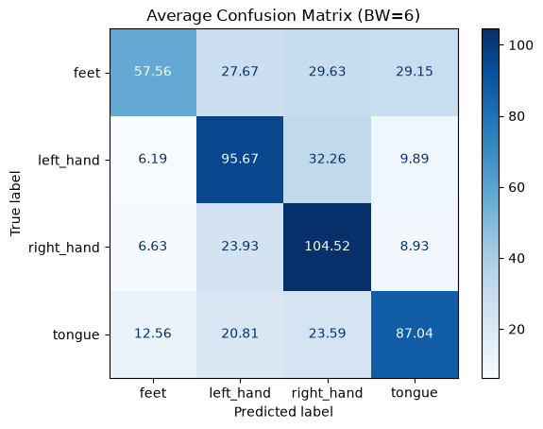
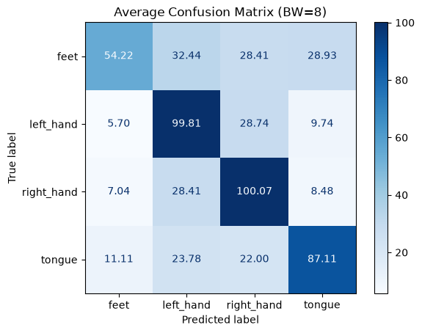
Eegnet – missing frequencies – test
 | 4 | 6 | 8
Acc | 60.8 | 59.9 | 59.2

Slide 43
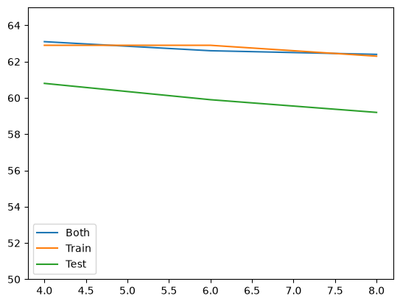
Eegnet – missing frequencies – summary

Slide 44
Class summaries
Feet:
Most affected by mismatch in test
Consistently confused with tongue
Left and right hand:
Most robust
Consistently confused with one another
Rarely predicted as tongue or feet
Tongue:
Robust but gets confused under large mismatches
Consistently confused with tongue

Slide 45
Week 7

Slide 46

eegnet
Best accuracy: 48.3%
Recall: 69.67

Slide 47




Eegnet – Scaling – both
 | 0.5 | 1.5 | 2 | 2.5
Acc | 47.5 | 44.7 | 47.6 | 47.4

Slide 48




Eegnet – Scaling – Train
 | 0.5 | 1.5 | 2 | 2.5
Acc | 39.9 | 44.0 | 44.4 | 40.5

Slide 49




Eegnet – Scaling – test
 | 0.5 | 1.5 | 2 | 2.5
Acc | 44.3 | 44.2 | 40.0 | 33.4

Slide 50

Eegnet – Scaling – summary

Slide 51




Eegnet – noise – both
 | 0.1 | 0.2 | 0.3 | 0.4
Acc | 47.9 | 45.8 | 46.1 | 46.4

Slide 52




Eegnet – noise – train
 | 0.1 | 0.2 | 0.3 | 0.4
Acc | 46.5 | 46.0 | 42.8 | 44.7

Slide 53




Eegnet – noise – test
 | 0.1 | 0.2 | 0.3 | 0.4
Acc | 46.3 | 46.8 | 45.4 | 43.5

Slide 54

Eegnet – noise – summary

Slide 55




Eegnet – missing durations – both
 | 50 | 100 | 150 | 200
Acc | 44.6 | 43.4 | 44.6 | 44.6

Slide 56




Eegnet – missing durations – train
 | 50 | 100 | 150 | 200
Acc | 46.5 | 45.0 | 46.8 | 45.9

Slide 57




Eegnet – missing durations – Test
 | 50 | 100 | 150 | 200
Acc | 45.3 | 43.2 | 45.4 | 44.5

Slide 58

Eegnet – missing durations – summary

Slide 59



Eegnet – missing frequencies – both
 | 4 | 6 | 8
Acc | 46.8 | 46.8 | 47.0

Slide 60



Eegnet – missing frequencies – train
 | 4 | 6 | 8
Acc | 44.4 | 45.3 | 44.9

Slide 61



Eegnet – missing frequencies – test
 | 4 | 6 | 8
Acc | 47.2 | 46.1 | 46.2

Slide 62

Eegnet – missing frequencies – summary

Slide 63
Week 8

Slide 64

Per subject analysis - Scaling

Slide 65

Per subject analysis - noise

Slide 66

Per subject analysis – missing durations

Slide 67

Per subject analysis – missing frequencies

Slide 68

Per comparison to lda
Accuracy list is almost identical, subjects 4 and 7 seem to be hard on EEGNet, while 5, 6, and 2 have inherently challenging patterns

Slide 69

Recall per class

Slide 70


Pairwise tests

Slide 71

Correlation between sessions

Slide 72

Prediction frequency

Slide 73

Between Subject correlation
Class A | Class B | Holm adjusted P value | Significant
Feet | Left hand | 0.0469 | True
Feet | Right Hand | 0.0469 | True

